Slide 1
Updating Deployed Application

Slide 2
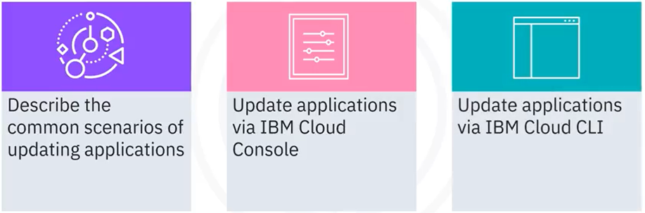
What you will learn

Slide 3
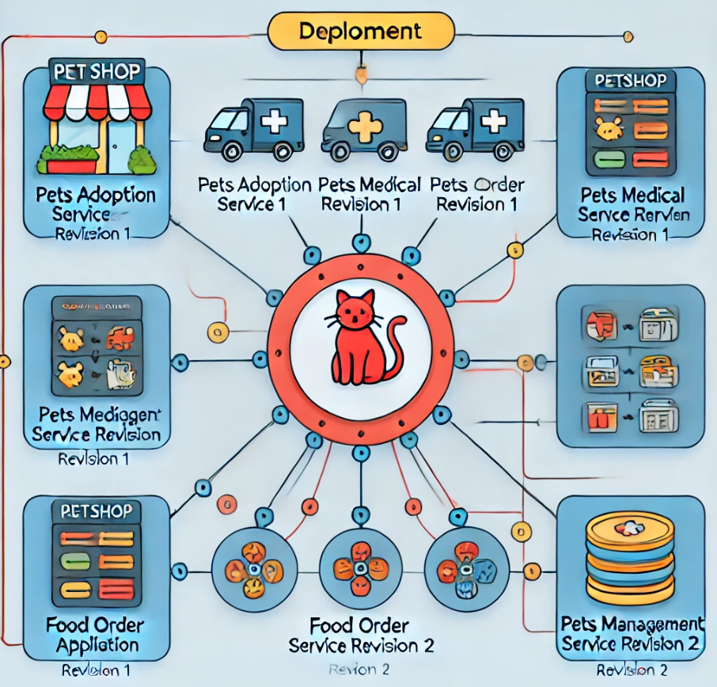
Updating of applications

Slide 4
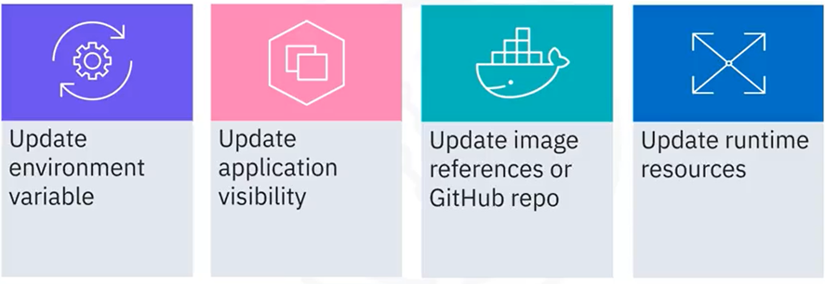
Common Updating Scenarios

Slide 5
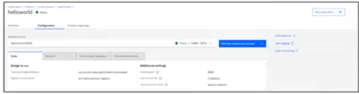
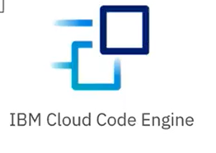



Methods to update application

Slide 6
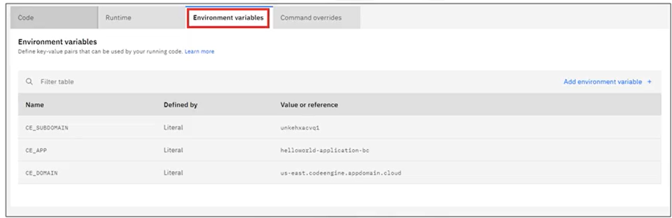
Update environment variable via Console

Slide 7
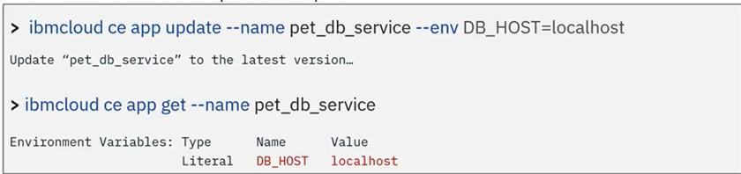
Update environment variable via CLI
ibmcloud ce app update
name : Name of your application
env : Environment variable
An environment variable update example:

Slide 8
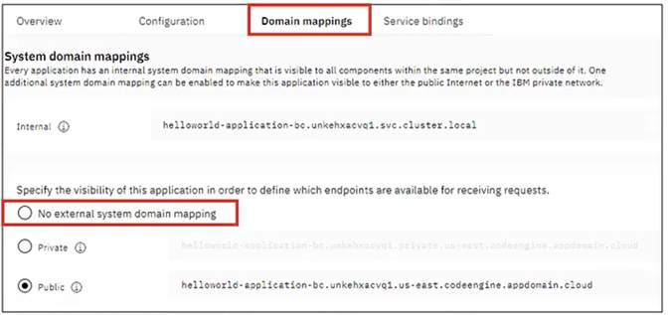
Update visibility variable via Console

Slide 9
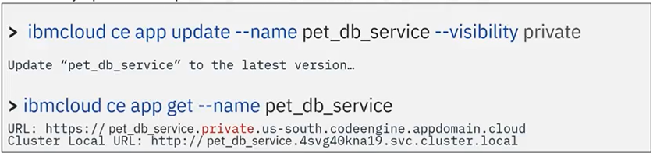
Update visibility via CLI
ibmcloud ce app update
name : Name of your application
visibility : The application visibility
A visibility update example:

Slide 10
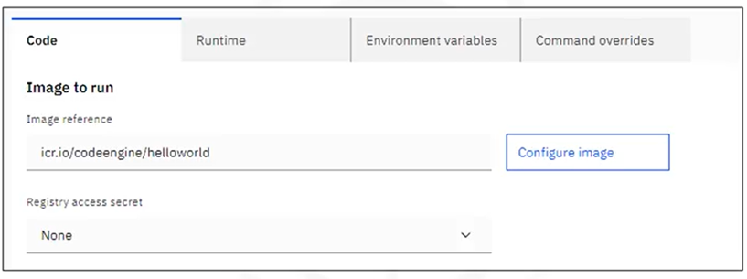
Update image reference via Console

Slide 11
Update image reference via CLI
ibmcloud ce app update
name : Name of your application
image : New Image reference
secret : Secret to access non-public container registry
An image reference update example:

Slide 12
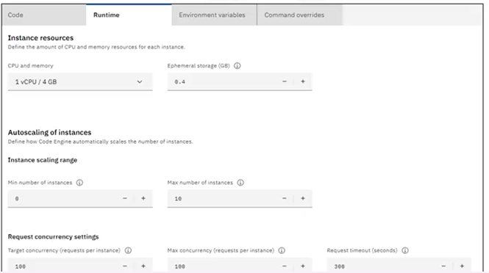
Update runtime resources via Console

Slide 13
Update CPU and Memory via CLI
ibmcloud ce app update
name : The name of your application
cpu : The amount of CPU set for the instance
memory : The amount of memory set for the instance
An image reference update example:

Slide 14
Recap
In this video, you learned that:
• You can create a Cloud Engine application either from a pushed
container image or a source code repository
• Per your preference, you can choose to use IBM Cloud Console
or IBM Cloud CLI to perform the application deployment tasks

